Slide 1

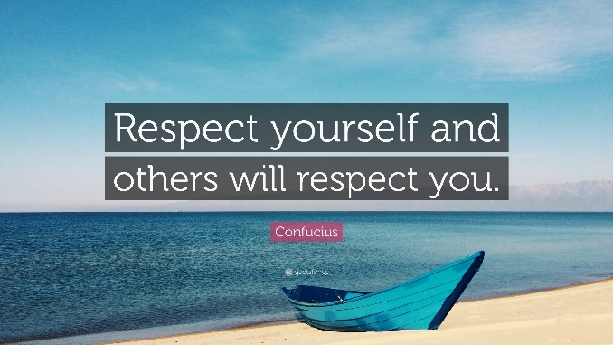

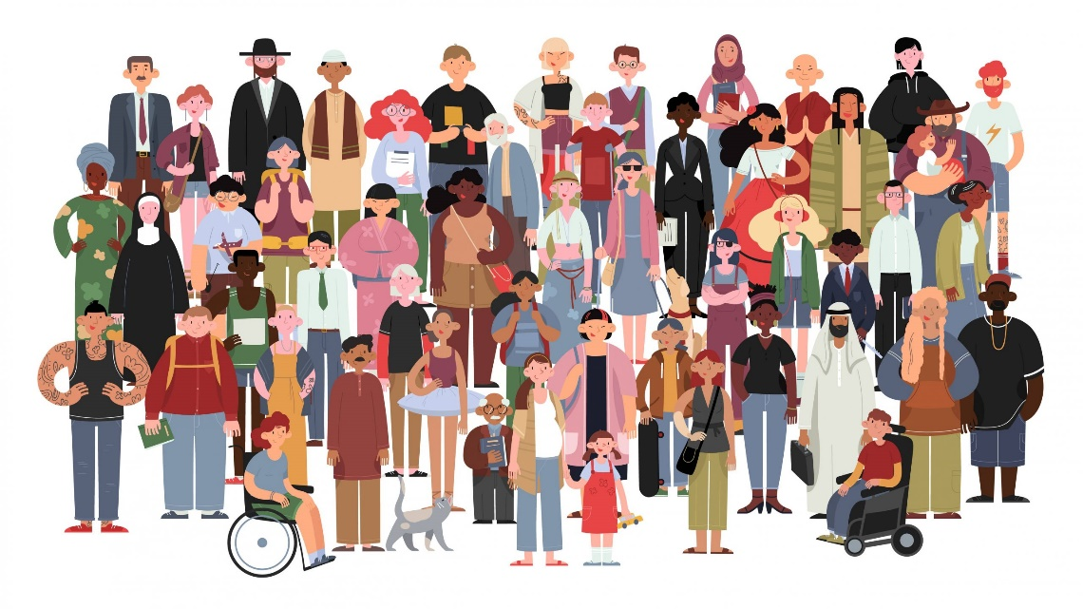

Life 360 Expectations
Everyone has the right to…
Participate or pass
Listen and speak
Privacy
An opinion
Learn
Everyone has the responsibility to…
Allow others to participate or pass
Listen and allow others to speak
Maintain privacy
Respect difference of opinion
Allow others to learn

Slide 2





Healthy relationships introduction: What are healthy relationships?
Do it now
Keiron and Sherelle have been dating on and off for six months. Keiron says he’s happy with Sherelle, apart from the fact she has cheated on him twice.
Sherelle says she loves Keiron, but wishes he wouldn’t shout and swear in her face when he gets angry.
Discuss: Do you think this sounds like a ‘healthy relationship’? Be ready to feedback your ideas to the class.
How might we expect two people in a healthy relationship to act towards each other? What indications might there be that a relationship is healthy?
Two people in a healthy relationship might treat each other……………..
However, an outsider can’t always tell if a relationship is really healthy because…

Slide 3

Healthy relationships introduction: What are healthy relationships?
New key term:
Learning intentions:
Describe what we might expect to see in a healthy relationship and in an unhealthy relationship. Explain the importance of learning about healthy relationships.
Healthy relationship – A healthy relationship is one in which both people feel a healthy sense of "self." Each person feels harmonious when spending time with the other person. Two emotionally healthy adults try to meet each other's needs, and each can ask for help without fear of criticism and knowing there is mutual levels of respect.

Slide 4
Task One:
When we talk about healthy relationships in PSHE, we aren’t just talking about relationships with partners. We’re talking about ANY and ALL relationships. When you think about it, there are so many different relationships in our lives which we need to be healthy.
How many you think of? Use your whiteboard to record your ideas.
Parent or guardian and child
Different types of relationships
Student and teacher

Slide 5
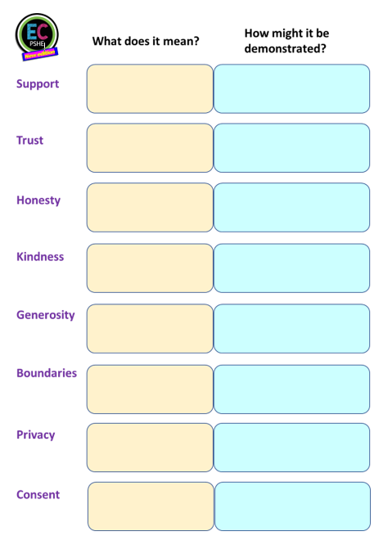
Task Two:
Healthy relationships are built on a number of factors. Below are some of the most important aspects of any healthy relationship.
Support
Trust
Honesty
Kindness
Generosity
Boundaries
Privacy
Consent
In pairs, discuss what you think the definition of each word is and record on your whiteboard or sheet (if using)
Now describe how each of the qualities could be demonstrated.
For example – a person could demonstrate consent by asking a person if they’d like a hug before actually hugging them.
Use the scaffolded task sheet if you wish.

Slide 6
Task Two:
Be ready now to correct any definitions that you need to. These are important key terms we’ll revisit a lot in our L360 lessons.
Support
Trust
Honesty
Kindness
Generosity
Boundaries
Privacy
Consent
To provide assistance or help to someone or a particular cause.
To have firm belief in the reliability, truth, or ability of someone or something.
Being truthful about things or to someone.
To treat someone well, to be considerate.
The action of being generous, sharing perhaps more than expected.
In this sense, having personal limits which shouldn’t be crossed.
In this sense, to have time or space to yourself
To have or give permission to do something

Slide 7

Task Three:
Watch the following clip (twice as it’s fast!) and complete it on your answer sheet or whiteboard. Your teacher will then go through the answers.
What Makes A Relationship Healthy? - YouTube
What changes as you get older? How might you feel?
What are unhealthy relationships like?
What are healthy relationships built on?
What might a person do in an unhealthy relationship?
Why is equality so important?
What are bad signs in a relationship?
How should you handle disagreements?

Slide 8
Task Three - ANSWERS:
What Makes A Relationship Healthy? - YouTube
What changes as you get older? How might you feel?
As you grow older, you may wish to be more independent and closer
to friends and feel like you may want a romantic or physical relationship.
What are unhealthy relationships like?
Unhealthy relationships can be complicated and stressful.
What are healthy relationships built on?
Healthy relationships are built on respect, equity and communication
What might a person do in an unhealthy relationship?
In an unhealthy relationship someone may tease or pressure you into doing something you are uncomfortable with.
Why is equality so important?
It’s important because you can co operate, comprise and respect each other.
What are bad signs in a relationship?
Bad signs include someone making all the decisions for you and checking up on your all the time
How should you handle disagreements?
Being willing to compromise, say what you mean and apologise if you
hurt each other.

Slide 9

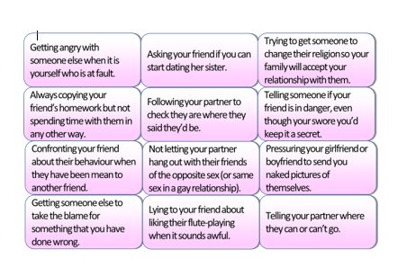
Healthy relationships introduction: What are healthy relationships?
Task Four:
Now we know what to look for in healthy relationships
and the factors these relationships are based on, we should
be able to spot what is healthy and what is unhealthy in
different scenarios.
Put it into practice!
Study the scenarios on the next slide and create two
headings on your whiteboard: Healthy and Unhealthy.

Slide 10
Healthy relationships introduction: What are healthy relationships?
?
Trying to get someone to change their religion so your family will accept your relationship with them.
Getting angry with someone else when it is yourself who is at fault.
Asking your friend if you can start dating her sister.
Telling your partner where they can or can’t go.
Pressuring your girlfriend or boyfriend to send you naked pictures of themselves.
Telling someone if your friend is in danger, even though your swore you’d keep it a secret.
Confronting your friend about their behaviour when they have been mean to another friend.
Not letting your partner hang out with their friends of the opposite sex (or same sex in a gay relationship).
Following your partner to check they are where they said they’d be.
Getting someone else to take the blame for something that you have done wrong.
Lying to your friend about liking their flute-playing when it sounds awful.
Always copying your friend’s homework but not spending time with them in any other way.

Slide 11
Healthy relationships introduction: What are healthy relationships?
?
This would happen in a healthy relationship
This is unhealthy behaviour for a relationship
Getting angry with someone else when it is yourself who is at fault.
Asking your friend if you can start dating her sister.
Trying to get someone to change their religion so your family will accept your relationship with them.
Always copying your friend’s homework but not spending time with them in any other way.
Following your partner to check they are where they said they’d be.
Telling someone if your friend is in danger, even though your swore you’d keep it a secret.
Confronting your friend about their behaviour when they have been mean to another friend.
Not letting your partner hang out with their friends of the opposite sex (or same sex in a gay relationship).
Pressuring your girlfriend or boyfriend to send you naked pictures of themselves.
Getting someone else to take the blame for something that you have done wrong.
Lying to your friend about liking their flute-playing when it sounds awful.
Telling your partner where they can or can’t go.

Slide 12
Checking for understanding:
Please complete the quick Microsoft form after teaching this lesson and taking a vote via hands up or whiteboards:
https://forms.office.com/e/iyjyPSgJ8V
Grade 1: Expert level of understanding
Grade 2: Mostly understood content
Grade 3: Some understanding of content
Grade 4: Don’t understand

Slide 13
Optional Task:
Most of the relationships we create through school and college are friendships. Not many of us think about keeping our friendships healthy, they sort of just happen. But often, not thinking at all can lead to falling out – or friendships turning into relationships when you didn’t ever intend them to! So how do we keep healthy friendships?
Don’t gossip about your friend
How do we keep healthy friendships?
Be loyal and honest
Keeping Friendships Platonic and Healthy - YouTube

Slide 14

Healthy relationships introduction: What are healthy relationships?
Extended Plenary:
‘How to distinguish and manage healthy relationships is the most important thing we can learn about in PSHE.’
Do you agree or disagree? Maybe you can see both sides of this argument.
You have ten minutes now to prepare your
mini essay (at least three paragraphs) about this statement. You may agree, disagree or be able to see both sides. Use all your completed tasks from today to help you as well as your own knowledge.
Use the scaffolding in PSHE sheet if you wish (next slide).

Slide 15
Scaffolding for PSHE specific literacy:
Starting sentences about importance:
It’s essential that we…
It’s always important to realise…
Essentially, we must all take note of…
Critically….
Starting sentences for
two-sided arguments:
We must consider both sides when…
On the one hand…
One point of view might be..
There are two opposing viewpoints on this subject..
Starting
sentences about opinion:
My personal opinion on this matter is…
It may be controversial,
but I believe…
My opinion is based on two factors….
Useful conjunctives:
Additionally
Furthermore
Subsequently
Similarly
In contrast
Nonetheless
However
©EC Publishing 2022/23
Concluding extended writing:
In conclusion…
When all has been considered..
Therefore as expressed…
In consideration of all the above..
Finally, when all has been considered…
Overall I would state…
Complete second part of argument, or second paragraph of PSHE extended writing piece.

