Slide 1



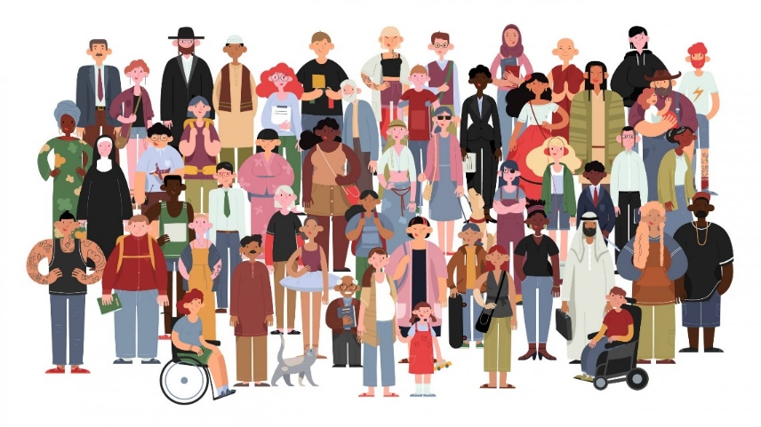

Life 360 Expectations
Everyone has the right to…
Participate or pass
Listen and speak
Privacy
An opinion
Learn
Everyone has the responsibility to…
Allow others to participate or pass
Listen and allow others to speak
Maintain privacy
Respect difference of opinion
Allow others to learn

Slide 2
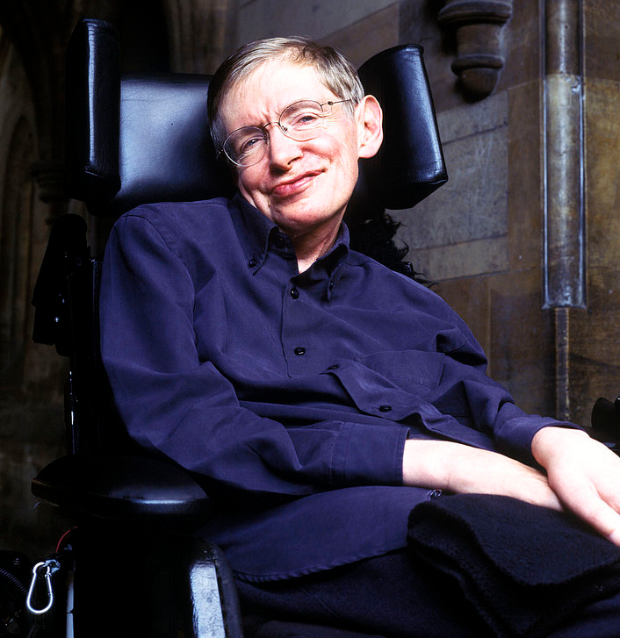
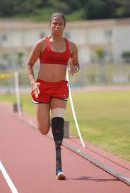

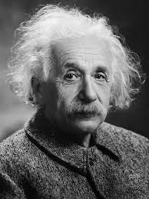
How are Disabled People Portrayed in the Media?
1
2
Starter
Challenge: Disabled people sometimes state that the media often shows negative images of them.
How would you describe the people in these pictures?
1
2
3
4
More challenging:
Is autism a disability? Is dyslexia? Explain.
Mega challenge:
Analyse the arguments for and against in your books.
3
4

Slide 3
How are Disabled People Portrayed in the Media?
Learning Outcomes
To explain how what the Equality Act of 2010 is, how the media can influence public views about disabled people and why disabled people feel they are stereotyped.
To describe how the Equality Act helps disabled people and present a balanced argument about how the media influences public opinion
To be able to assess the impact of the Equality Act and how media portrayal affects disabled people.
https://www.youtube.com/watch?v=bwW6mYdJ7Xc
Watch the clip and note down what the speakers say about how they want non-disabled people to see them. We’ll then investigate whether the media is meeting these expectations.

Slide 4
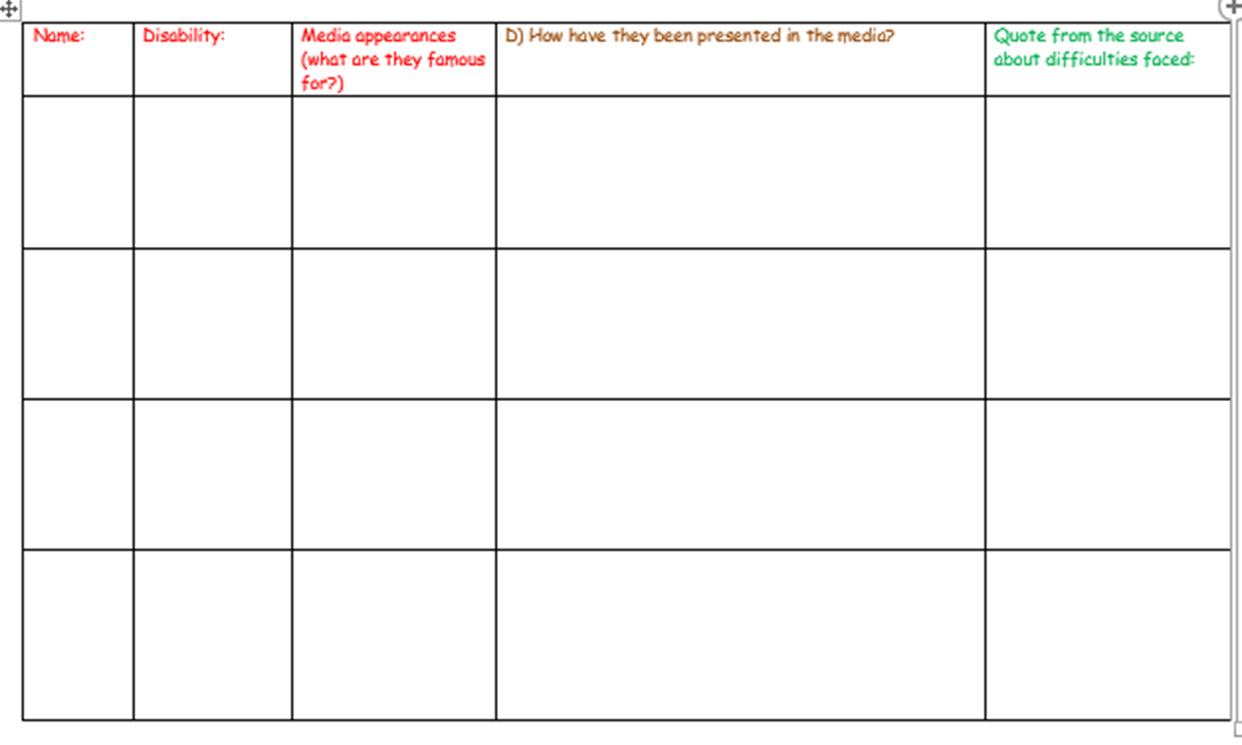
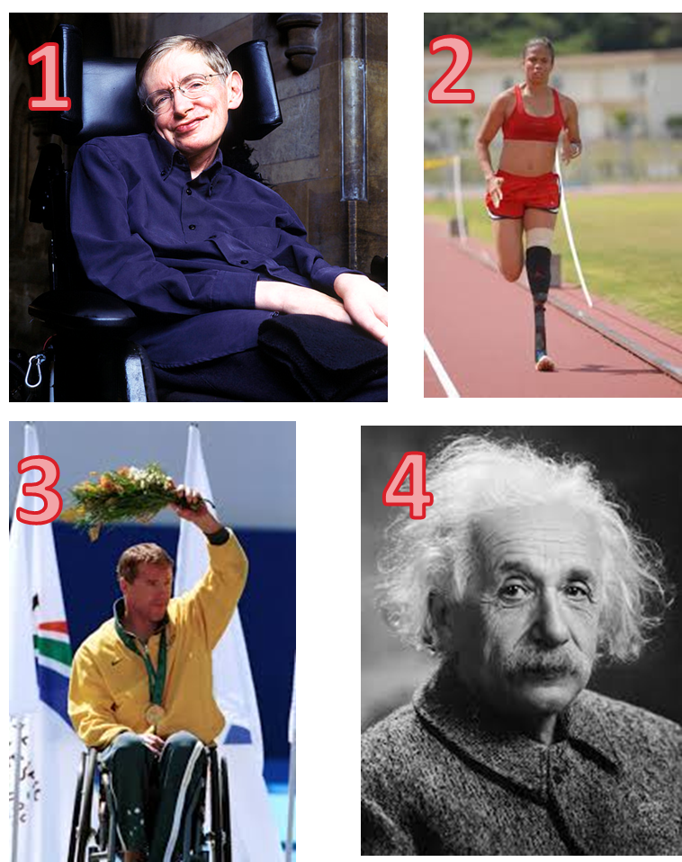

How are disabled people portrayed in the media?
Task One:
On your table there are a variety of sources about how disabled people are portrayed in the media.
Complete your capture sheet and collect evidence to summarize the extent to which people with disabilities are stereotyped in the media.
Ensure you complete the sources at your challenge levels.

Slide 5
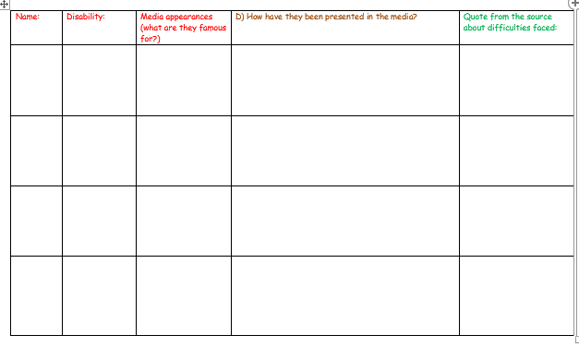
Review: Complete any blank spaces as we go through them. You will need detailed notes for the next task.

Slide 6
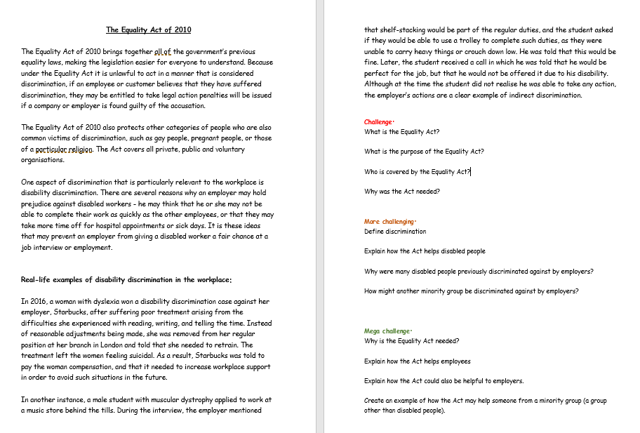

Task two – What is the Equality Act of 2010? How has it helped disabled people in the UK?
Read the handout you have just been given (or on the next slide) and then choose a set of challenge questions to answer.
Level up!
Finished? Have a go at the next set up.
https://www.youtube.com/watch?v=UuIdq_ftQY8
(optional afterwards)

Slide 7
The Equality Act of 2010
The Equality Act of 2010 brings together all of the government’s previous equality laws, making the legislation easier for everyone to understand. Because under the Equality Act it is unlawful to act in a manner that is considered discrimination, if an employee or customer believes that they have suffered discrimination, they may be entitled to take legal action penalties will be issued if a company or employer is found guilty of the accusation.
The Equality Act of 2010 also protects other categories of people who are also common victims of discrimination, such as gay people, pregnant people, or those of a particular religion. The Act covers all private, public and voluntary organisations.
One aspect of discrimination that is particularly relevant to the workplace is disability discrimination. There are several reasons why an employer may hold prejudice against disabled workers - he may think that he or she may not be able to complete their work as quickly as the other employees, or that they may take more time off for hospital appointments or sick days. It is these ideas that may prevent an employer from giving a disabled worker a fair chance at a job interview or employment.
Real-life examples of disability discrimination in the workplace:
In 2016, a woman with dyslexia won a disability discrimination case against her employer, Starbucks, after suffering poor treatment arising from the difficulties she experienced with reading, writing, and telling the time. Instead of reasonable adjustments being made, she was removed from her regular position at her branch in London and told that she needed to retrain. The treatment left the women feeling suicidal. As a result, Starbucks was told to pay the woman compensation, and that it needed to increase workplace support in order to avoid such situations in the future.
In another instance, a male student with muscular dystrophy applied to work at a music store behind the tills. During the interview, the employer mentioned that shelf-stacking would be part of the regular duties, and the student asked if they would be able to use a trolley to complete such duties, as they were unable to carry heavy things or crouch down low. He was told that this would be fine. Later, the student received a call in which he was told that he would be perfect for the job, but that he would not be offered it due to his disability. Although at the time the student did not realise he was able to take any action, the employer’s actions are a clear example of indirect discrimination.

Slide 8
Questions
Challenge:
What is the Equality Act?
What is the purpose of the Equality Act?
Who is covered by the Equality Act?
Why was the Act needed?
More challenging:
Define discrimination
Explain how the Act helps disabled people
Why were many disabled people previously discriminated against by employers?
How might another minority group be discriminated against by employers?
Mega challenge:
Why is the Equality Act needed?
Explain how the Act helps employees
Explain how the Act could also be helpful to employers.
Create an example of how the Act may help someone from a minority group (a group other than disabled people).

Slide 9

Task three
“The way the media shows disabled people always has an impact on the way we see disabled people”
Write a balanced answer to show whether you agree/disagree with the statement.
Your answers must use evidence from your capture sheet to justify your ideas.
On one hand, I agree that the way the
media portrays disabled people will impact
upon the way we view disabled people because…
On the other hand, ……

Slide 10



Checking for understanding:
Please complete the quick Microsoft form after teaching this lesson and taking a vote via hands up or whiteboards:
https://forms.office.com/e/iyjyPSgJ8V
Grade 1: Expert level of understanding
Grade 2: Mostly understood content
Grade 3: Some understanding of content
Grade 4: Don’t understand

