Slide 1



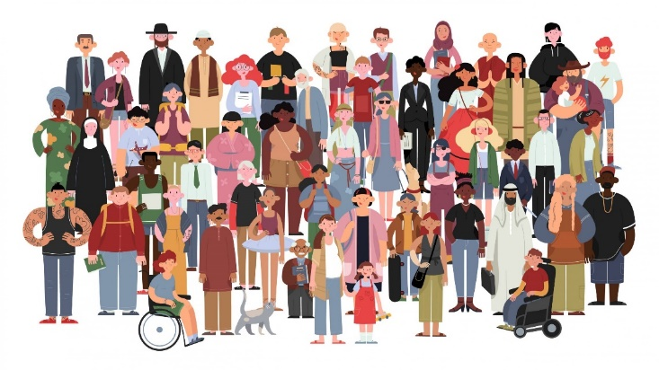

Life 360 Expectations
Everyone has the right to…
Participate or pass
Listen and speak
Privacy
An opinion
Learn
Everyone has the responsibility to…
Allow others to participate or pass
Listen and allow others to speak
Maintain privacy
Respect difference of opinion
Allow others to learn

Slide 2


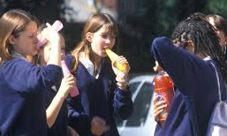
Peer pressure – why is it so powerful and how can we overcome it?
Do it now:
Emma’s friends have snuck
a bottle of pop with vodka
in it to school. They are
taking it in turns to drink some in the car park. Emma really doesn’t want it – it tastes horrid and she doesn’t want to get in trouble. Emma still has a sip of it, despite her worries.
Questions
1, What could the consequences be of what Emma just did? What does Peer Pressure mean?
2,Why did Emma do this, even though she didn’t want to? Explain.
3, Emma is usually a good student, yet she has taken a really stupid risk. Analyse how powerful peer pressure can be.

Slide 3
Peer pressure – why is it so powerful and how can we overcome it?
Lesson intentions:
Identify strategies to resist peer pressure and reasons this can be so difficult.
Describe the best ways particular case studies can resist peer pressure and the meaning of herd mentality.
Explain the difference herd mentality, herd behaviour and peer pressure and analyse which strategies will work best in which case.
Peer Pressure - direct influence on people by peers, to follow by changing their attitudes, values, or behaviours to conform to those of the influencing group.

Slide 4

TASK ONE:
Watch the clip and answer the questions below:
What kind of pressures are students sometimes put under?
What strategies can help?
What happened to the boys that cheated? Was it worth the risk?
What is your ‘inner voice’ – how can it help?
What is manipulation – how does recognising this is happening help?
How does imagining what your parents/ guardians would say help?
How can having strong self-esteem help you overcome peer pressure?
https://www.youtube.com/watch?v=ZA09vyY76g8

Slide 5

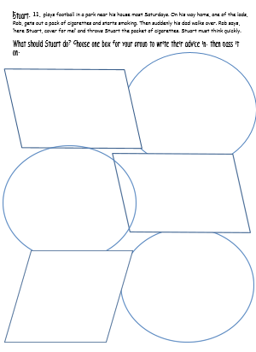
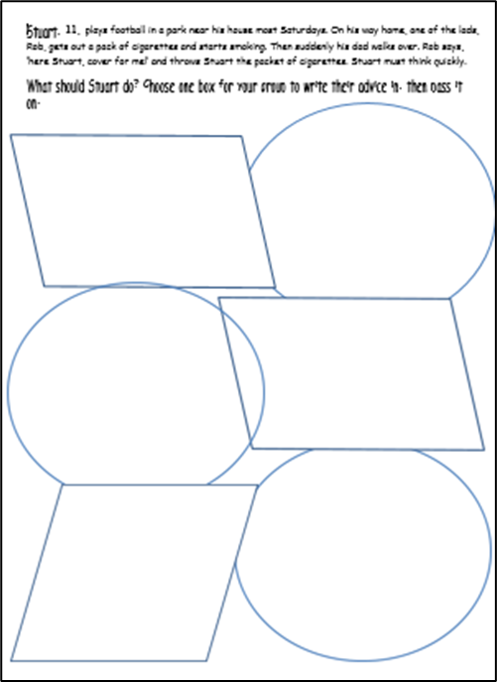

TASK 2:
We’re now going to examine some case studies.
Read the case studies in your pairs and complete one of the spaces with your advice.
After a few minutes your teacher will tell you to pass it on to the next group. Be prepared to feed back your answers to the class.
Hint – use the strategies you learned in the video!

Slide 6
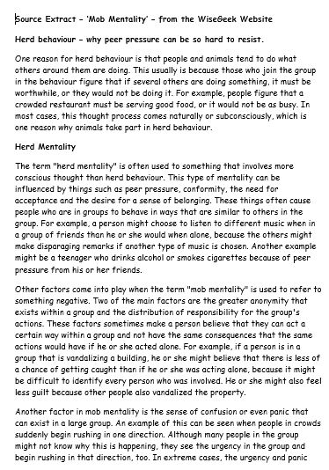


So why is peer pressure so hard to resist?
READING ALOUD OPPORTUNITY!
We’ll now read a source extract as a class.
Challenge: In pairs identify five reasons why peer pressure is so hard to resist according to the article.
Underline the reasons on the sheet and then describe them in your own words in your books.
1, Explain why good students often cave in to peer pressure, using quotes from the article explained in your own words.
2, Explain the difference between herd mentality, herd behaviour and peer pressure. Which of the strategies we’ve learned about would help us most in each case? Analyse.

Slide 7


To finish:
Write down the three best strategies
you’ve learned today for coping with peer
pressure. Number them in order of how
Well you think they’ll work for you.
Be prepared to feedback your answer as
lesson exit ticket.
Lesson intentions:
Identify strategies to resist peer pressure and reasons this can be so difficult.
Describe the best ways particular case studies can resist peer pressure and the meaning of herd mentality.
Explain the difference herd mentality, herd behaviour and peer pressure and analyse which strategies will work best in which case.

Slide 8


Checking for understanding:
Please complete the quick Microsoft form after teaching this lesson and taking a vote via hands up or whiteboards:
https://forms.office.com/e/168rpeRpnW
Grade 1: Expert level of understanding
Grade 2: Mostly understood content
Grade 3: Some understanding of content
Grade 4: Don’t understand

