Slide 1
UCAS SIGN UP

Slide 2
By the end of the session you will have…
Registered with UCAS
Completed the following parts of your application:
  Personal details
  Nationality details
  Where you live
  Contact details
  Supporting information
  Finance & funding
  Education
ALL STUDENTS MUST COMPLETE THIS, EVEN IF YOU DO NOT INTEND TO STUDY AT UNIVERSITY

Slide 3
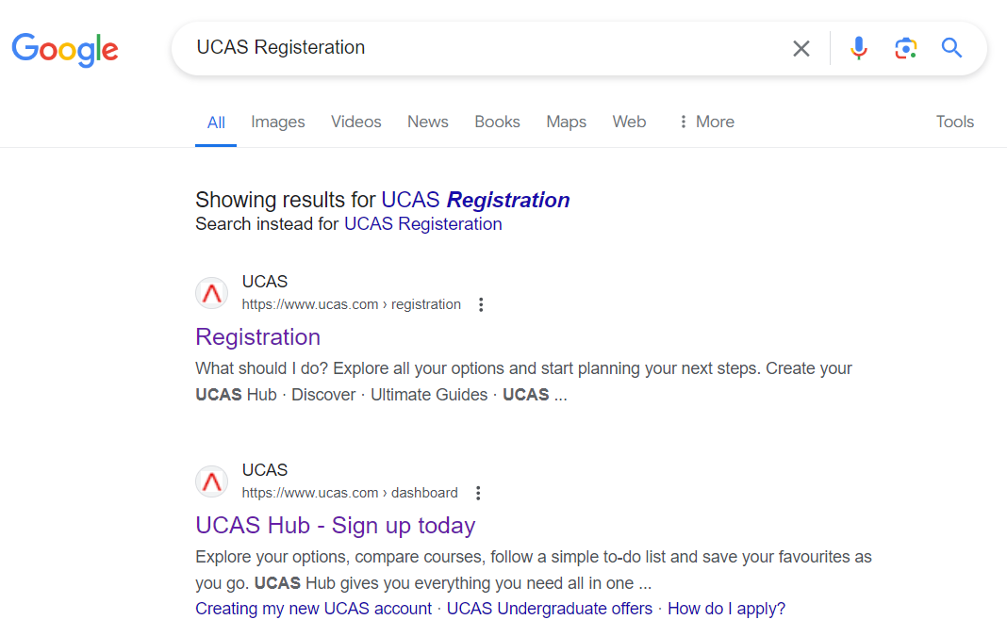
How to register:
Copy this link:
or
Type into google: ‘UCAS registration’
and click UCAS Hub – Sign up today
https://accounts.ucas.com/account/login?returnUrl=https%3A//www.ucas.com/dashboard%23/

Slide 4
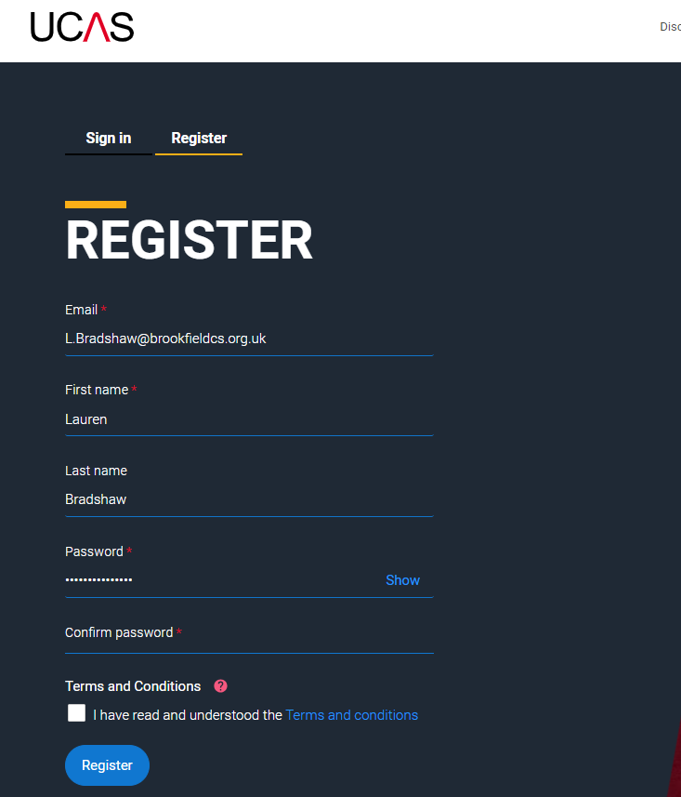
How to register:
Complete the registration details
YOU MUST USE YOUR PERSONAL EMAIL, NOT YOUR SCHOOL
Confirm that you have read and understood the T&C’s
Click: Register

Slide 5
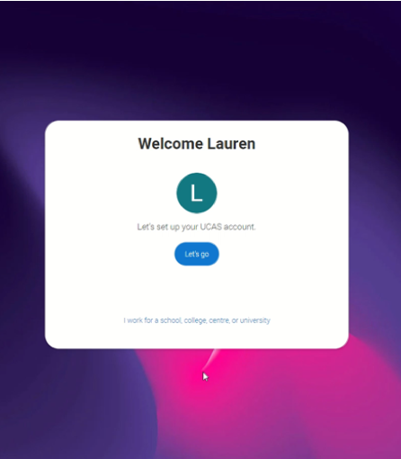
How to register:
Click: Let’s go

Slide 6
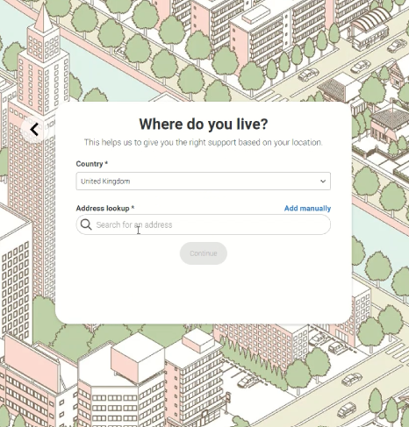
How to register:
Select United Kingdom
Search for your home address, NOT SCHOOL!

Slide 7
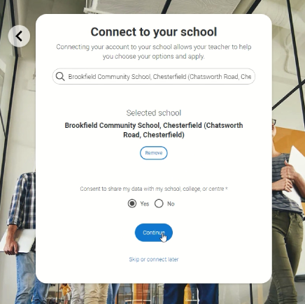
How to register:
Type and select Brookfield Community School
YOU MUST LINK TO BROOKFIELD, OTHERWISE WE CANNOT COMPLETE YOUR REFERENCE

Slide 8
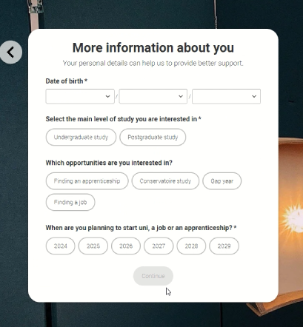
How to register:
Complete your D.O.B
Select Undergraduate study
Select any other opportunities you are interested in
Select 2025, unless you are planning on deferring your place. (If you are, please inform your tutor)

Slide 9
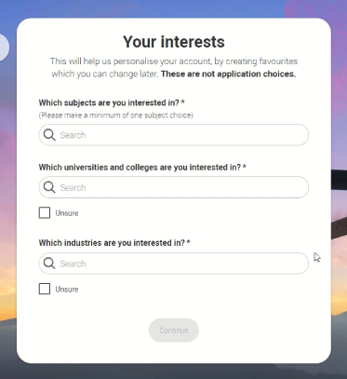
How to register:
Type the subject you are interested in studying. You can choose more than one!
Complete the remaining two questions. You can click unsure

Slide 10
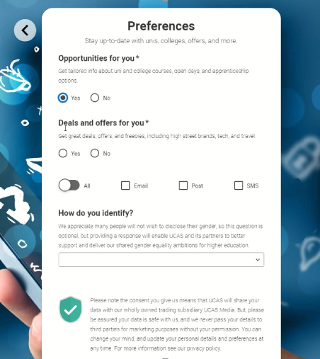
How to register:
Complete your preferences

Slide 11
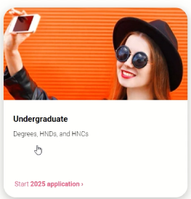
How to register:
Click Undergraduate

Slide 12
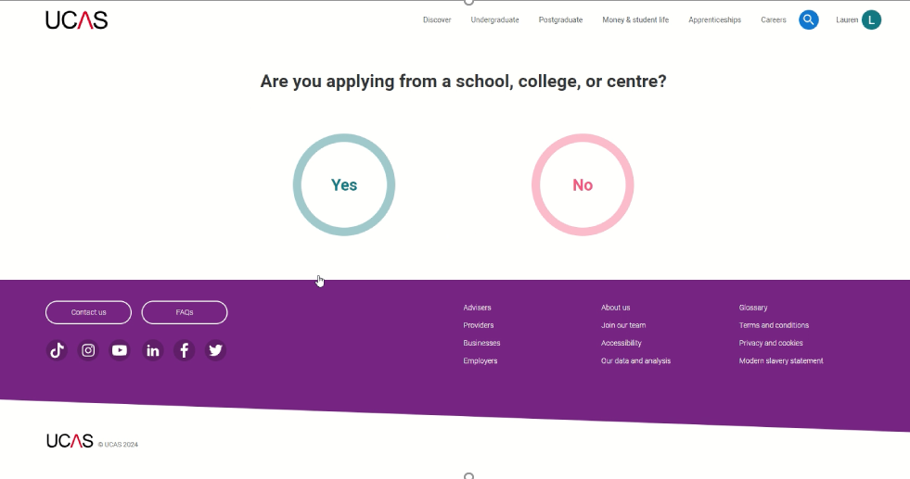
How to register:
Click Yes

Slide 13
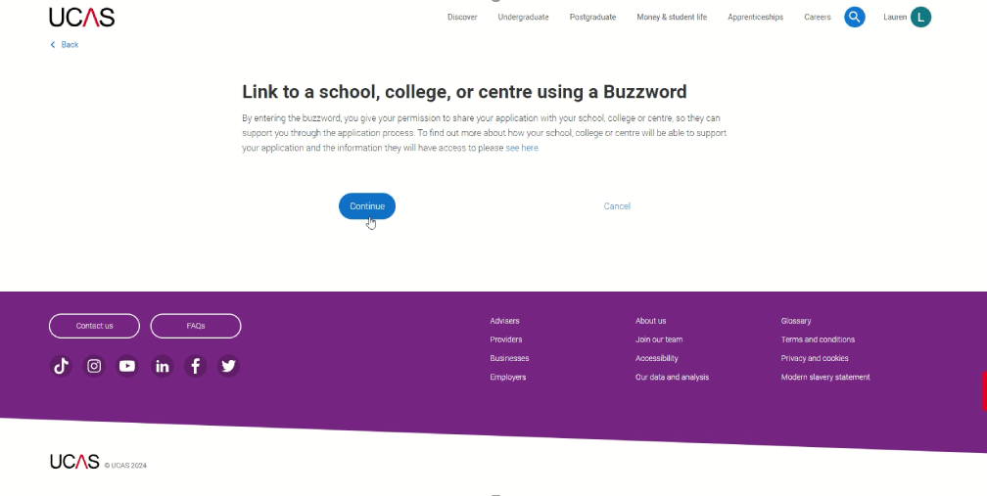
How to register:
Click Continue

Slide 14
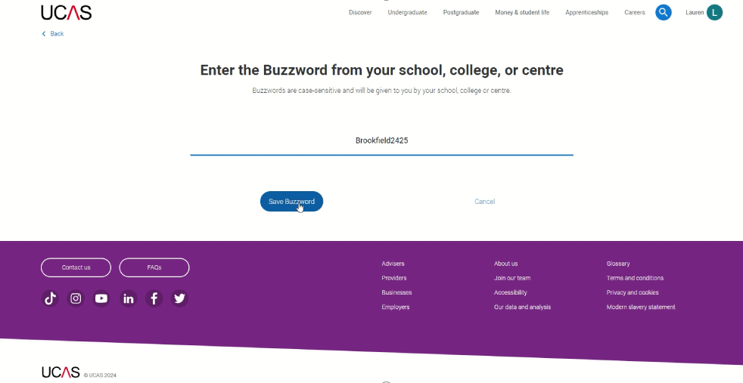
How to register:
Enter the Buzzword:
Brookfield2425
This will link you to the school enabling us to complete your reference
IF YOU HAVE NOT BEEN ASKED TO ENTER A BUZZWORD, YOU HAVE NOT SIGNED UP CORRECTLY

Slide 15
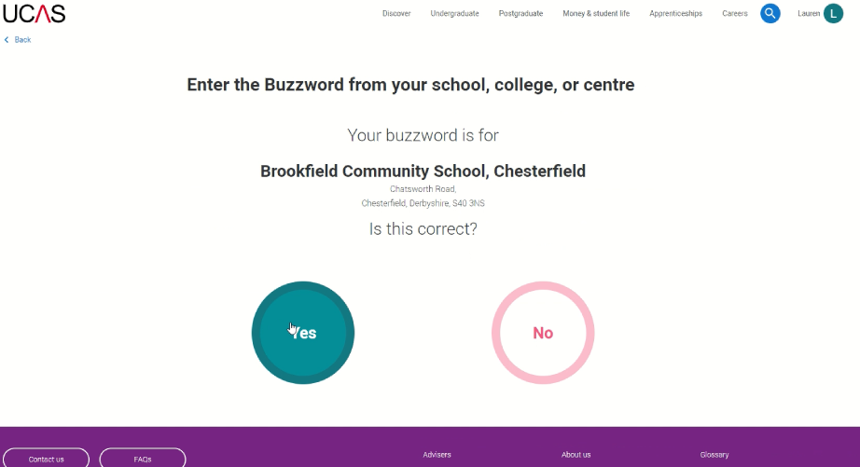
How to register:
Check that Brookfield Community School has been linked and select Yes

Slide 16
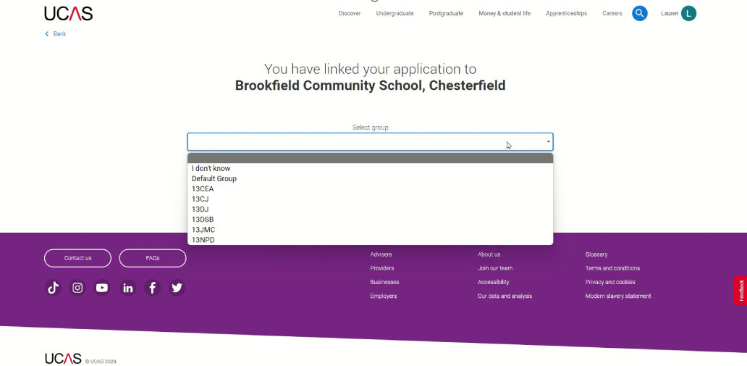
How to register:
Select your tutor group

Slide 17
You have now registered and will be directed to your UCAS Dashboard.
This is where you will begin your application

Slide 18
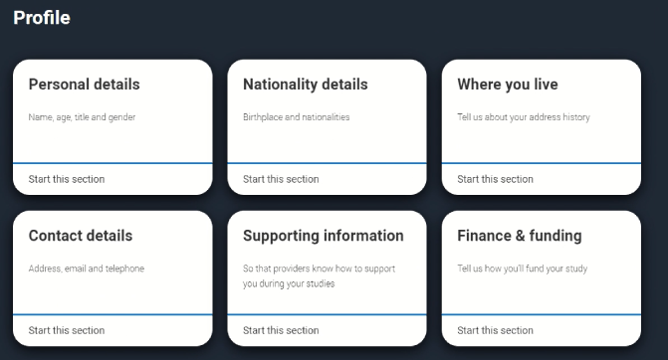

Slide 19
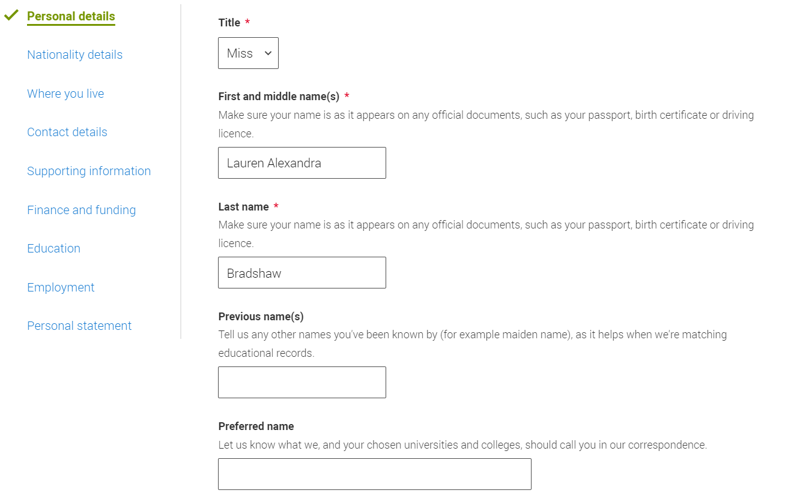
Personal Details
If you have a middle name, ensure you include this
USE CAPITAL LETTERS WHERE NEEDED
When you have completed a section, it will appear green with a tick to the left.

Slide 20
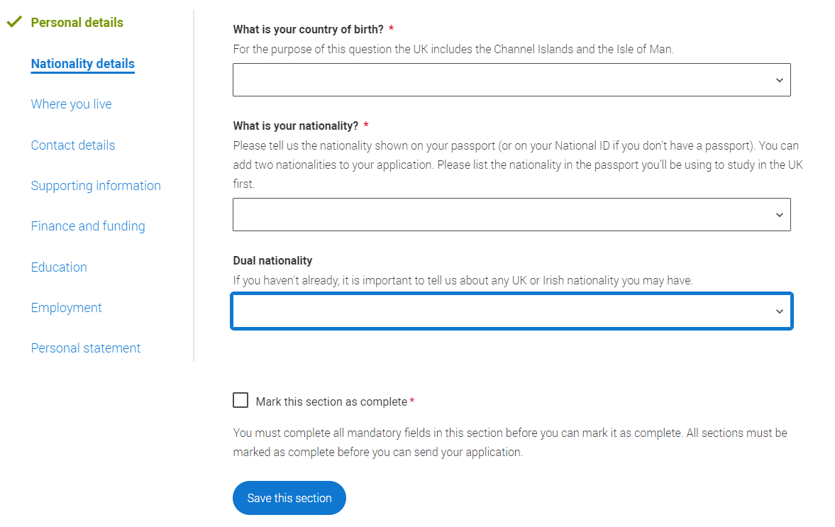
Nationality Details
If unsure, check your nationality on your passport when you get home.

Slide 21
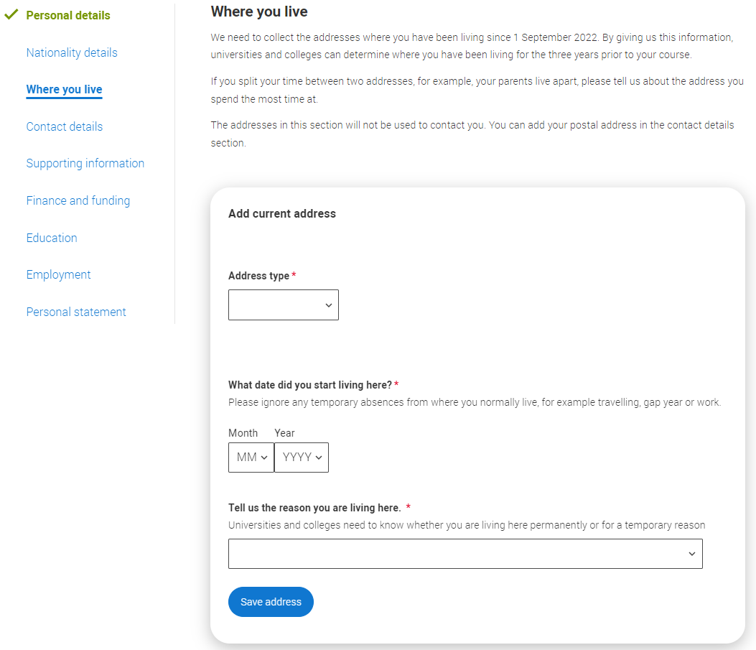
Where you live
Address type: UK address
Tell us the reason you are living here: Permanent home (Speak to your tutor if this may not be the case)
Residential category: UK Citizen - England

Slide 22
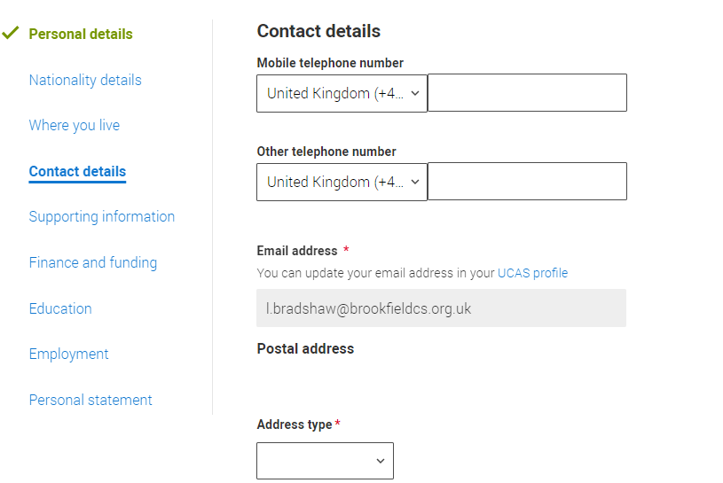
Contact details
Address type: UK address

Slide 23
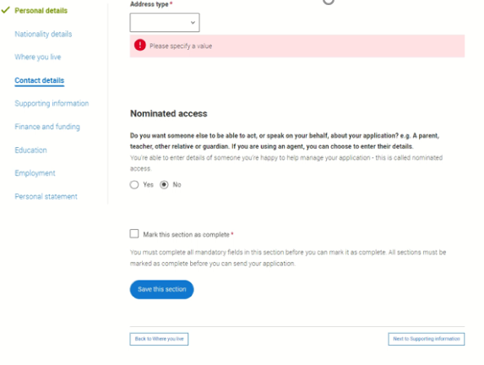
Nominated Access
If you would like someone to be able talk to UCAS on your behalf, select yes to nominated access.

Slide 24
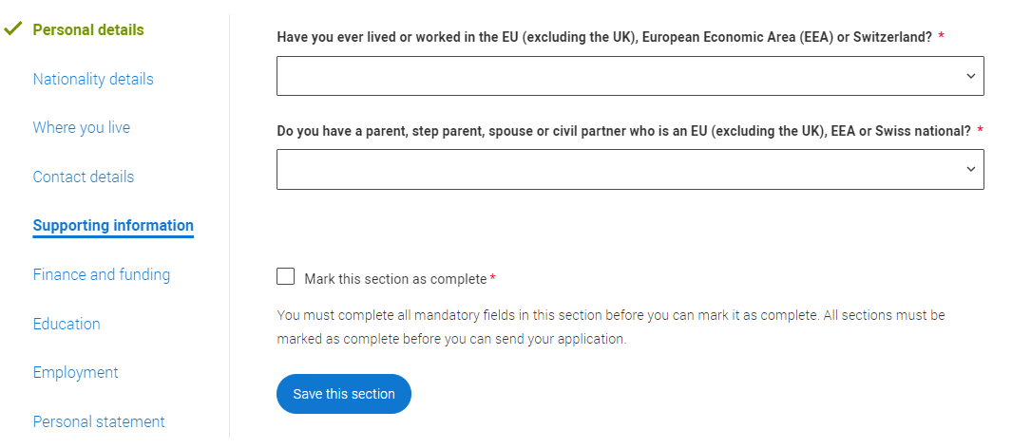
Supporting information
Speak to your tutor if the answer is yes.

Slide 25
The ‘Education’ section is the most tricky section to complete and is where lots of pupils make mistakes
It is VITAL that you add all of your qualifications correctly

Slide 26
Education: You need to include…
GCE Advanced Level (A-Level) inc. Criminology
GCE Advanced Subsidary (EPQ, Core Maths)
General Certificate of Secondary Education (Grade: 9-1)
  If you did Combined Science: GCSE: Double Award (9-9 to 1-1)
  If you did triple Science, add each as a separate GCSE

Slide 27
Also include in Education
Graded music, dance and drama
  Dance
  Drama and Speech
  Music Qualification - Graded Practical (ABRSM and equivalent)
  Music Qual.- Graded Theory (ABRSM and equiv.)
  LAMDA Cert in Speech and Drama Perf Studies (PCert LAM)
Other Qualifications
  Additional Admissions Test
  Duke of Edinburgh Award
  Functional Skills
  Free Standing Mathematics Unit (Old) / Qualification (New) (FSMQ)

Slide 28
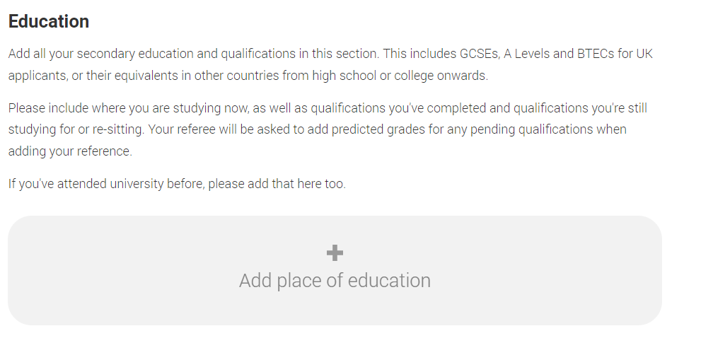
Education
Click: Add place of education

Slide 29
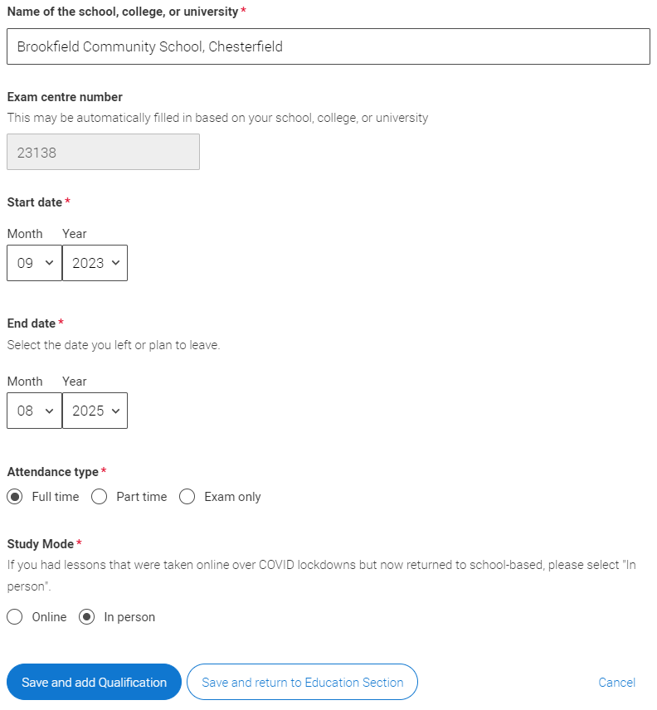
Education
If you did not study at Brookfield in Y7- now
Start Date: 09/2023
End Date: 08/2025
If you studied at Brookfield from Y7 – now
Start Date: 09/2018
End Date: 08/2025
Select: Full time
Select: In person

Slide 30
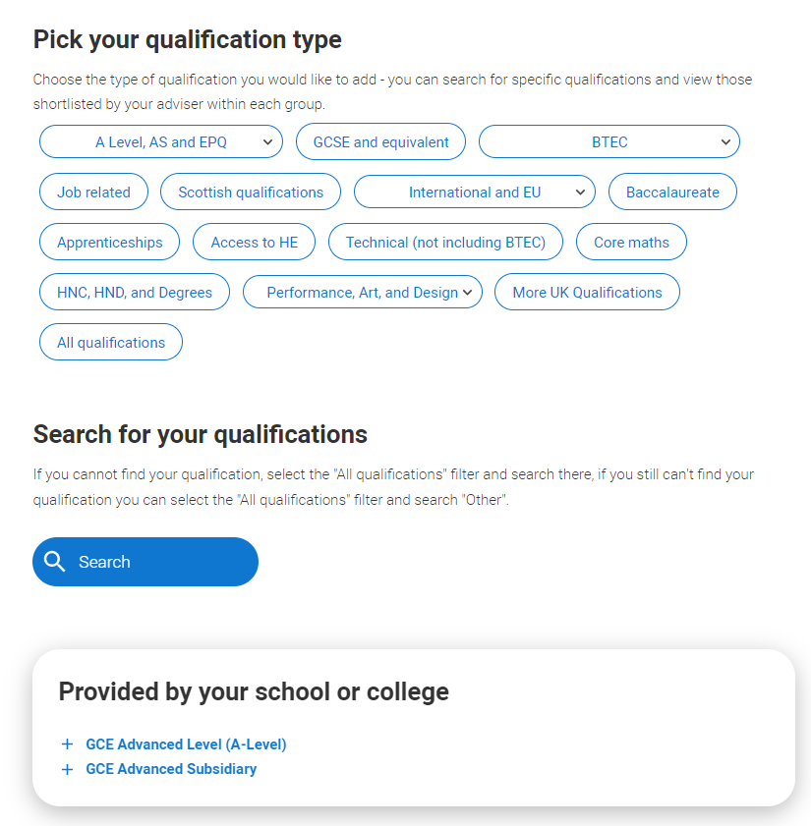
Education
Select the qualification type
Scroll down and select a qualification from ‘Provided by your school or college’.

Slide 31
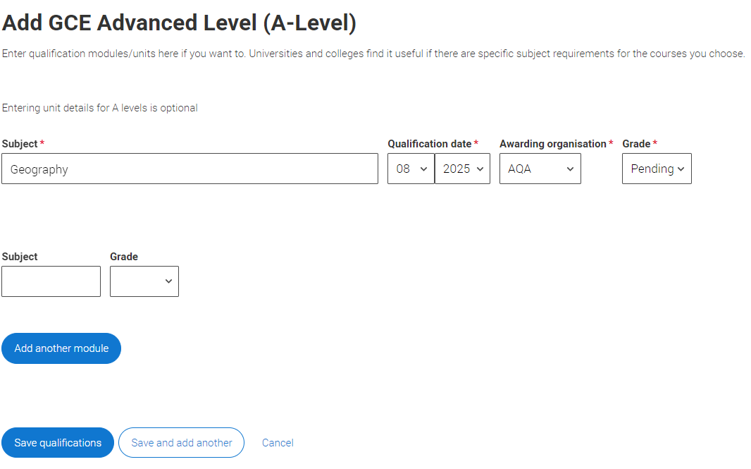
Education
Type in your subject
Qualification date: 08/ 2025
Awarding organisation: Exam board that you study
Grade: Pending

Slide 32
You need to add all of your qualifications in this section before clicking ‘Section Complete’
GCE Advanced Level (A-Level)
GCE Advanced Subsidary (AS-Level)
General Certificate of Secondary Education (GCSE’s)
Graded music, dance and drama

